Slide 1
Mobile Price Prediction Using KNN Classifier
Submitted by
Debjit Ganguli Debdyuti Saha Chhandak Patra Protyush Mukherjee Aniruddha Poddar
Under the guidance of Shri Debayan Ganguly
Professor,
Dept. of Computer Science and Engineering

Slide 2
OBJECTIVE
We use a dataset that contains the features of a mobile that affect its price, namely processor clock speed, RAM capacity, front camera, primary camera, internal memory and so on. The dataset can be found at www.kaggle.com [1]
20 features were used as input with the output being the price range.
We code different models with different feature selection algorithms like Linear Regression, Logistic Regression, Random Forest Classifier and KNN Classifier.
KNN Classifier is chosen because it has the most accuracy among all the models. The value of k is chosen to be 13 because it provides us the most accuracy.
Test data evaluation shows that the KNN Classifier model with k = 13 is able to predict the price range with an accuracy of 92.62%.

Slide 3
INTRODUCTION
MOTIVATION
With so many mobile brands, models and features to choose from, we are left confused to which phone we must buy. We are torn in anxiety, are we receiving the right value for our money?
This is where this project comes in, we take a dataset of mobile phones and their features along with a price range.
We create a Machine Learning model to predict the price range of a mobile based on its feature, using the data of the previous mobile phones in our dataset.
The models we use are: Linear Regression, Logistic Regression, Random Forest Classifier and KNN Classifier. We check the accuracy for each and choose the model with the most accuracy.

Slide 4
BACKGROUND
In our dataset, we have a train file and a test file. But the test file has no data for price range, so we have to split the training data into training data and testing data to find the accuracy of the models. We will use the test dataset to predict the price range of those mobiles and compare some features with the training dataset to check if our model works as expected.
The training dataset has 2000 rows, with 21 features. The testing dataset has 1000 rows, with 20 features. The testing dataset does not include price_range, so we will use our model to predict price_range.

Slide 5
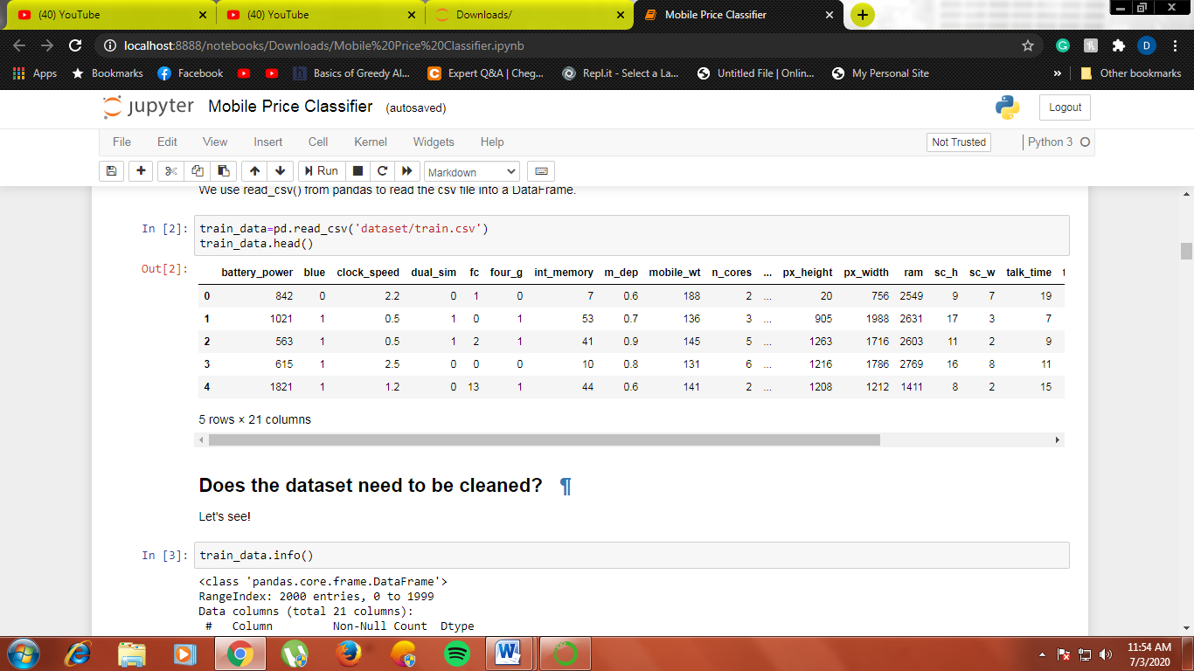
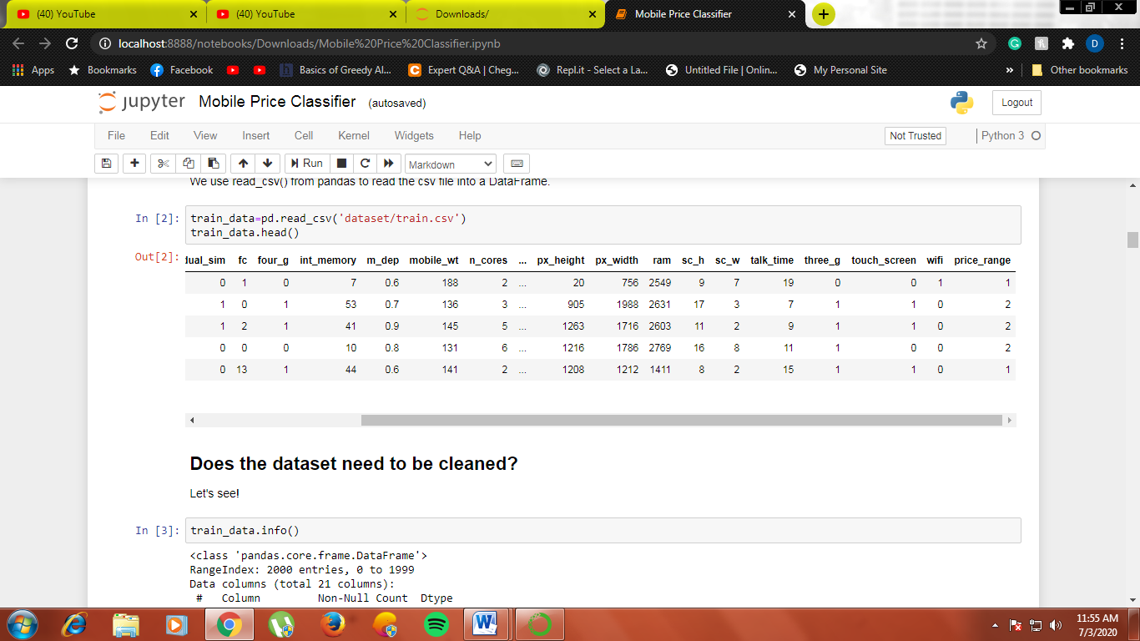
First 5 rows of the dataset using head()

Slide 6
SUMMARY OF PREVIOUS WORK
The previous work on this dataset can be found at www.medium.com [3].
In our project, we try to use simpler models that can be explained easily and have similar accuracy as the models used earlier.
We also try to find a feature that has a high impact on price. For the feature, we find average values in every price range in the training dataset and keep it noted. We predict the price range for every phone in testing dataset, and find average values for the feature in every price range and compare the values.

Slide 7
SOFTWARES USED
We use Python 3.7 as our base programming language. The packages we import in Python are:
numpy – To deal with statistics
pandas – To read the csv files, store it and perform various operations on it
matplotlib and seaborn – To create graphs
sklearn.model_selection – To split data into training data and testing data
sklearn.linear_model – To create Linear Regression and Logistic Regression models
sklearn.ensemble – To create Random Forest Classifier model
sklearn.neighbors – To create K Nearest Neighbours model
sklearn.metrics – To find the confusion matrix for the model we select

Slide 8
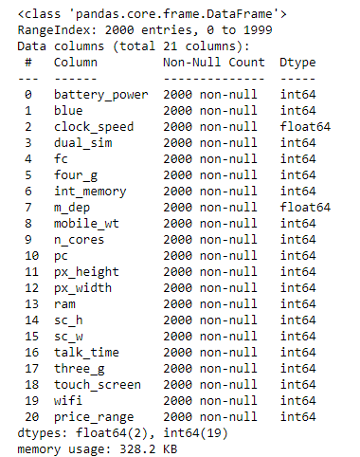
PREPROCESSING
Since the dataset is a csv file, we use read_csv() from pandas to read the training dataset into a DataFrame. We use info() on our DataFrame. We get the following:
All the columns have 2000 non-null values, so the dataset does not need any cleaning. Hence we can proceed without much preprocessing.

Slide 9
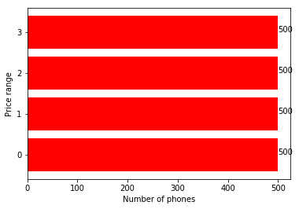
NUMBER OF PHONES IN EACH PRICE RANGE
We count the number of phones in each price range, 0 to 3, and graph them to have an initial idea of how well distributed the data is.
Each price range has 500 mobiles. The dataset is very evenly distributed.

Slide 10
EFFECTS OF FEATURES ON PRICE
In this section, we try to find which feature has a significant effect on the price of a mobile. We find the average value of a feature in every price range and graph it, and then we try to see if the difference is significant or not.
We also try to explain some ambiguous feature effects on price

Slide 11
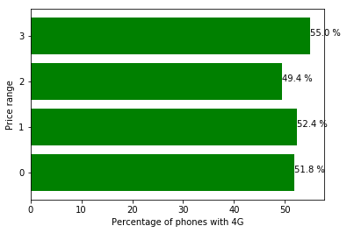
PERCENTAGE OF 4G PHONES IN EACH PRICE RANGE
Since phones that support 4G require better hardware, it makes sense for phones with 4G support to be more expensive than other phones. We find the percentage of 4G phones in each price range.
The graph makes sense, since expensive phones are more likely to support 4G than cheaper phones. However, we see that the expensive price range has lower number of 4G phones than average and cheap price range.

Slide 12
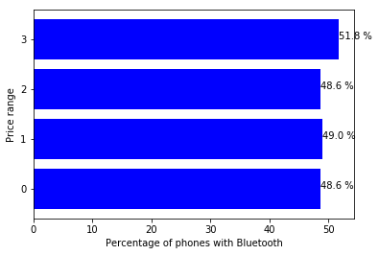
PERCENTAGE OF PHONES WITH BLUETOOTH IN EACH PRICE RANGE
Bluetooth is another very important feature for mobiles, since it enables media sharing across mobiles. We find the percentage of phones with Bluetooth in each price range.

Slide 13
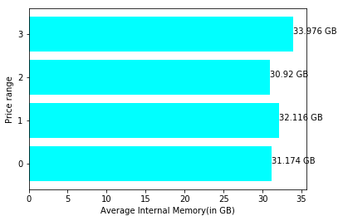
Average Internal Memory of phones at different price ranges
We find the average internal memory of phones in each price range.
Internal memory is almost the same for all price ranges, since most mobiles will have the same internal memory but different features at different price ranges. However, very expensive phones are more likely to have more internal memory than cheaper phones.

Slide 14
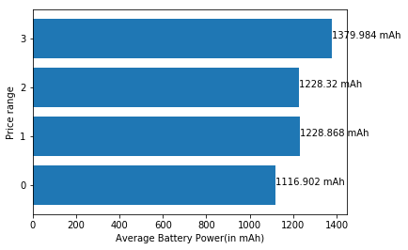
Average Battery Power of phones at different price ranges
The battery power of a phone will determine how long the phone can be used before it needs to be charged again. We find the average battery power of phones in each price range.
Phones at higher price range are likely to have more battery power, which makes complete sense.

Slide 15
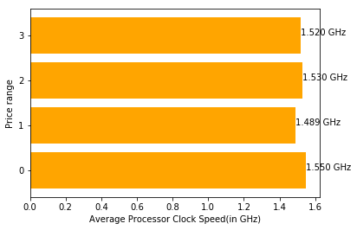
Average Processor Clock Speed of phones at different price ranges
The clock speed of a processor determines how fast it can execute instructions. We find the average processor clock speed of phones in each price range.
As we can see, phones in very cheap category have a higher average clock speed processor than phones at higher price ranges. This is owing to the fact that the more clock speed of processors does not directly equal better performance.

Slide 16
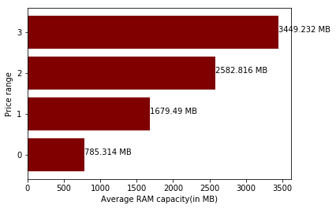
Average RAM capacity of phones at different price ranges
The RAM of a phone is very important for people who want to multitask. A little change in RAM can mean a huge boost in performance. We find the average RAM capacity of phones in each price range.
The difference in RAM capacity in each price range is drastic. RAM is a very important feature in determining the price of a phone. We will use this feature to check if our predictions are accurate later.

Slide 17
Creating models and finding the best accuracy
As we discussed before, the test file has no data for price range, so we have to split the training data into training data and testing data to find the accuracy of the models. We split them on a 60:40 basis.
We create 4 different models. They are:
1. Linear Regression
2. Logistic Regression
3. Random Forest Classifier
4. K Nearest Neighbours Classifier
Models 1-3 were simple and straight forward, however K Nearest Neighbours Classifier differs with the value of k set.

Slide 18
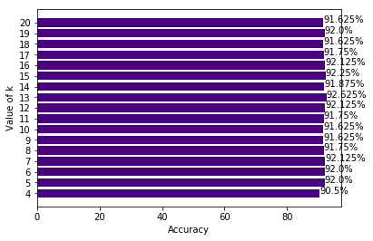
K Nearest Neighbours Classifier
We create a different model for different values of k and compare the accuracies. We select k to be a minimum of 4, since there are 4 classes to be classified in price range.
Since accuracy is maximum for k=13, we select KNN classifier with k=13.

Slide 19
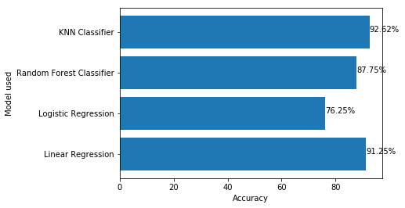
Selecting a model
We select a model from the models we create by graphing the accuracies.
Linear Regression and KNN Classifier have almost the same accuracy. We choose KNN Classifier since we are dealing with classification here instead of discrete values, and Linear Regression is a better choice for regression with continuous values.

Slide 20
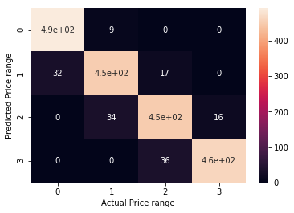
Confusion Matrix of KNN Classifier model
The Confusion Matrix is heavier in the diagonals, suggesting a pretty accurate model.
The few inaccuracies are 1 price range apart, since sometimes companies can choose to overprice their phone based on brand value while some companies lower prices to eliminate the competition.

Slide 21
Predicting price range in test data
As we discussed earlier, the test dataset has no column for price_range. So, we use our model to predict the price_range for the test dataset. There is, however, no way of knowing if the results are correct. As we covered earlier, the average RAM capacity is pretty significant at different price ranges, so we can compare the average RAM capacities for the test dataset to check if our model is working as expected.
We read the test dataset into a DataFrame using read_csv() from pandas. Then we use predict() from our KNN Classifier model to get the predicted values.

Slide 22
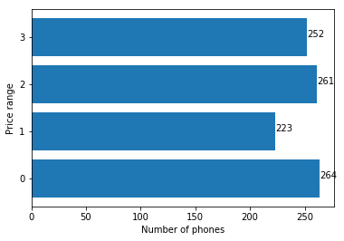
Number of phones in each price range in test dataset
We count the number of phones in each price range, 0 to 3, and graph them to check how distributed the price ranges are.
Except for price range 1, all the other ranges are very well distributed again.

Slide 23
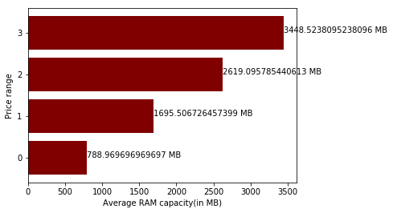
Average RAM capacity of phones at different price ranges in test dataset
As we have seen earlier, RAM capacity is one of the features that affects price the most. The difference in average RAM capacity at different price ranges is pretty solid.
The average RAM capacity for each price range in test dataset is almost the same as that of testing dataset, so we can safely conclude that our model is working pretty well.

Slide 24
FUTURE SCOPE
The accuracy of our KNN classifier is 92.62%, but the accuracy can be improved by using advanced AI tools such as Convolution Neural Network (CNN).
To achieve maximum accuracy and predict more accurate, more and more instances should be added to the data set.
And selecting more appropriate features can also increase the accuracy. So data set should be large and more appropriate features should be selected to achieve higher accuracy. [4]

Slide 25
REFERENCES
[1] https://www.kaggle.com/iabhishekofficial/mobile-price-classification, Abhishek Sharma
[2] ANN for Predicting Mobile Phone Price Range, Ibrahim M. Nasser and Mohammed Al-Shawwa, IJAISR, Pg. 2
[3] https://medium.com/@sai.teja667edu/mobile-price-prediction-using-machine-learning-classification-techniques-1893262704e6, Saiteja
[4] Mobile Price Class prediction using Machine Learning Techniques, Muhammad Asim and Zafar Khan, IJCA, Pg. 11

